Slide 1

Labelling Hidden Services with Image Recognition
Prepared By: Akansha Sudhirkumar Singh
Roll Number: 202191015
Under Guidance of Dr. S. G. Bhirud
Academic Year: 2021-22

Slide 2
Contents
Introduction
Literature Survey
Literature Gaps
Motivation
Project Objectives
Problem Statement
Proposed Approach
Dataset Cleaning
Labeling the Training Dataset
Train-Validation Split
Architect the Model
Results
Next Steps
Conclusion
References

Slide 3
Introduction
A hidden service is a site you visit or a service you use that uses Tor technology to stay secure and, if the owner wishes, anonymous.[2]
“Hidden services” are also known as “onion services”.[2]
Example:
The anonymity provided by TOR represents a perfect breeding ground for illegal activities.
Thus hidden services can be used to carry out illegal and unethical activities by cyber criminals or terrorists.
This makes analysis of hidden services and identifying the type of hidden service important.

Slide 4
Introduction - A Hidden Service
HTML Files
Image Files
Hidden Service
CSS Files
JavaScript Files
PHP Files

Slide 5
Literature Survey

Slide 6
Literature Survey
Image Classification Techniques
Dark Web Concepts
Classification of Mango Leaves Infected by Fungal Disease Anthracnose Using Deep Learning (Conference 2021) [26]
A Case Study of Image Classification Based on Deep Learning Using Tensorflow (Others 2018) [37]
A Study on CNN Transfer Learning for Image Classification (Conference 2018) [40]
For more: Literature Review
The Dark Web as a Phenomenon: A Review and Research Agenda (Others 2018)[15]
Dark Web and Its Impact in Online Anonymity and Privacy: A Critical Analysis and Review (Journal 2019)[28]
Dark Web: A Web of Crimes (Others 2020)[29]
Evolution of Dark Web Threat Analysis and Detection: A Systematic Approach (Conference 2020) [3]
For more: Literature Review
Dark Web Text Analysis
Classifying Illegal Activities on Tor Network Based on Web Textual Contents (Conference 2017) [14]
An Unsupervised Model for Identifying and Characterizing Dark Web Forums (Journal 2021) [42]
For more: Literature Review

Slide 7
Literature Survey
Weapons Detection System
Dark Web Vendor Identification
Application of Deep Learning for Weapons Detection in Surveillance Videos (Conference 2021) [12]
For more: Literature Review
Towards Image-Based Dark Vendor Profiling (Conference 2020) [13]
You Are Your Photographs: Detecting Multiple Identities of Vendors in the Darknet Marketplaces (Others 2018) [21]
For more: Literature Review
Fake Currency Detection
Review on Detection of Fake Currency using Image processing Techniques (Conference 2021) [10]
For more: Literature Review
Pornography and Child Sexual Abuse Detection in Image and Video: A Comparative Evaluation (Conference 2017) [24]
For more: Literature Review
Pornography and Child Sexual Abuse Detection

Slide 8
Literature Survey
Text Analysis Techniques
Multi-class dark web Image Classification
Data Analysis by Web Scraping using Python (Conference 2019) [27]
Inscriptis - A Python-based HTML to text conversion library optimized for knowledge extraction from the Web (Journal 2021) [30]
Towards Classifying HTML-embedded Product Data Based On Machine Learning Approach (Others 2021) [31]
For more: Literature Review
Dark Web Analysis
Illegal Activity Categorisation in DarkNet Based on Image Classification Using CREIC Method (Conference 2018) [1]
Classifying suspicious content in TOR darknet through Semantic Attention Keypoint Filtering (Journal 2019) [7]
Recognition of Service Domains on TOR Dark Net using Perceptual Hashing and Image Classification Techniques (Conference 2017) [16]
For more: Literature Review
Tor: Hidden Service Intelligence Extraction (Others 2018) [22]
Mining the Dark Web: A Novel Approach for Placing a Dark Website under Investigation (Others 2019) [33]
Influence of COVID-19 Epidemic on Dark Web Contents (Others 2021) [23]
For more: Literature Review

Slide 9
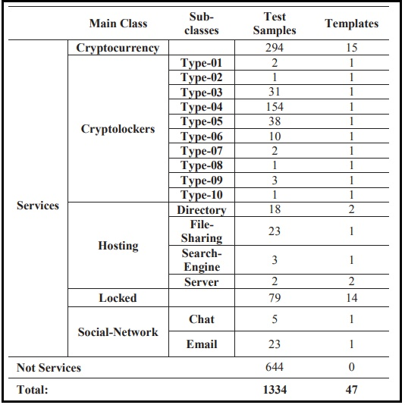
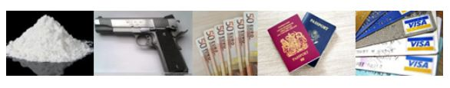
Literature Survey
Darknet Usage Service Images
Dark Web Datasets
1334
698
TOR Image Categories
Rubel Biswas, Eduardo Fidalgo, Enrique Alegre; “Recognition of Service Domains on TOR Dark Net using Perceptual Hashing and Image Classification Techniques”, 8th International Conference on Imaging for Crime Detection and Prevention, ICDP-2017, Madrid 13-15 Dec. 2017 [16]
Eduardo Fidalgo, Enrique Alegre, Víctor González-Castro , Laura Fernández-Robles ; “Illegal Activity Categorisation in DarkNet Based on Image Classification Using CREIC Method”; Conference 2018 [1]

Slide 10
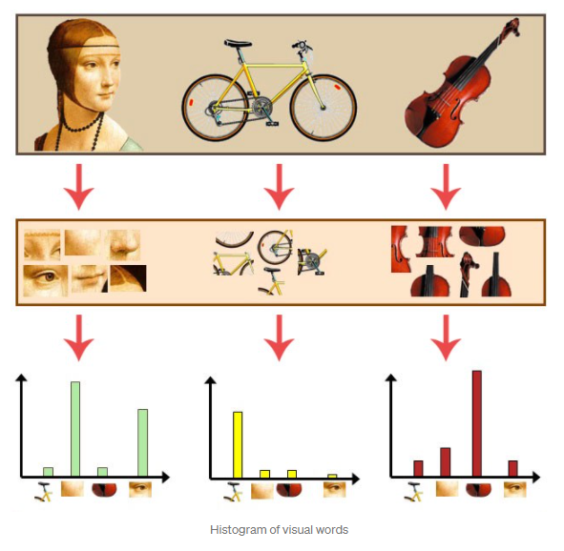
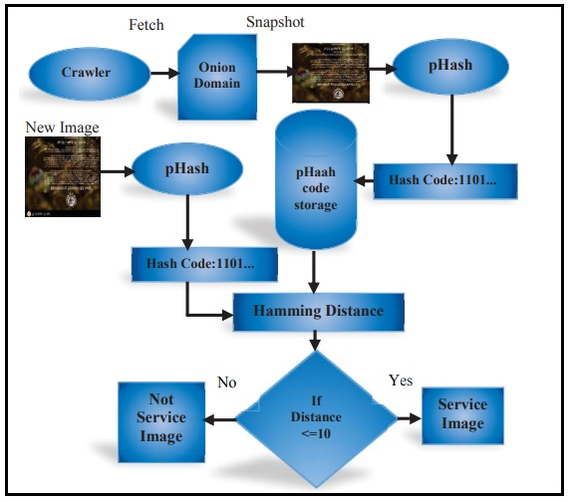
Bag of Visual Words (BOVW) [6] vs Perceptual Hashing[16]
Eduardo Fidalgo, Enrique Alegre, Víctor González-Castro , Laura Fernández-Robles ; “Illegal Activity Categorisation in DarkNet Based on Image Classification Using CREIC Method”; Conference 2018 [1]
Rubel Biswas, Eduardo Fidalgo, Enrique Alegre; “Recognition of Service Domains on TOR Dark Net using Perceptual Hashing and Image Classification Techniques”, 8th International Conference on Imaging for Crime Detection and Prevention, ICDP-2017, Madrid 13-15 Dec. 2017

Slide 11
Literature Gaps
Most of the methods or techniques that considers analysis of Dark Web visual data are focused on a particular domain like Child Sex Abuse (CSA) or Weapons.
Even if some researches considers having content from more than one class as seen in TOR Image Categories(TOIC) and Darknet Usage Service Images(DUSI), focus is on some specific classes leaving other classes to be explored.
Dataset used in these researches are not public.
The analysis of text data related to respective Image data to confirm the category is not done. This correlation between text and Image data can help in identifying the type of hidden service accurately.

Slide 12
Motivation
Most of the existing researches about image analysis on Dark Web focuses on a specific domain such as weapons or Child Sex Abuse Material.
Even if some researches considers content having more than one class, for example weapons, drugs, counterfeit money, etc., focus is on some specific classes leaving other classes to be explored.
Thus the motivation of this project is to contribute in the field of dark web image analysis and confirm the result of image analysis with textual data analysis of hidden services using the available dataset.

Slide 13
Project Objectives
Making publicly available a dark web labelled dataset.
Hidden service identification by image recognition.
Text data analysis for confirming co-relation between text data labelling and image recognition.

Slide 14
Problem Statement
The proposed work aims to identify type of hidden services by recognising the category of its images. The goal is also to create, present and make publicly available a labelled dark web image dataset, and confirm correlation between textual data and image data by performing analysis of image and related text data.

Slide 15
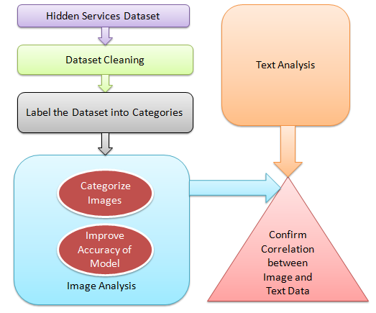
Proposed Approach

Slide 16
Dataset Cleaning
Removal of Hidden Services without Images
Removal of Irrelevant Images
Removal of files not to be considered for further process

Slide 17
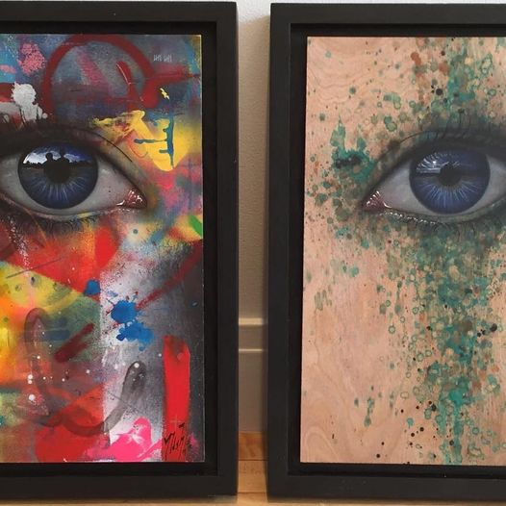
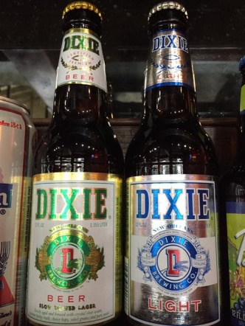

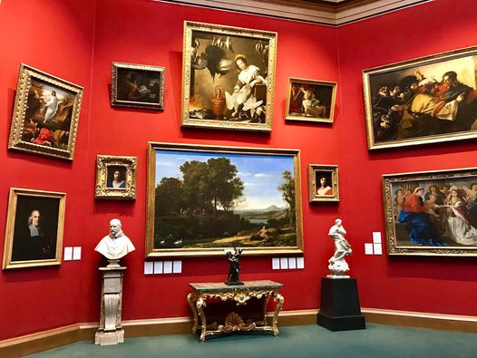

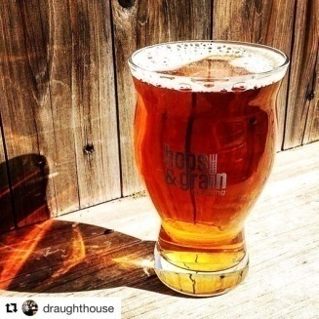
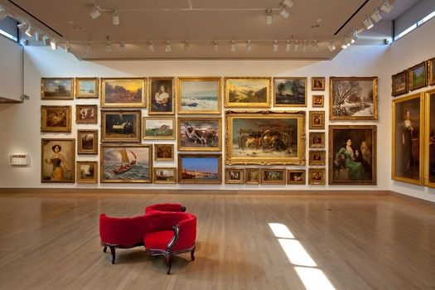
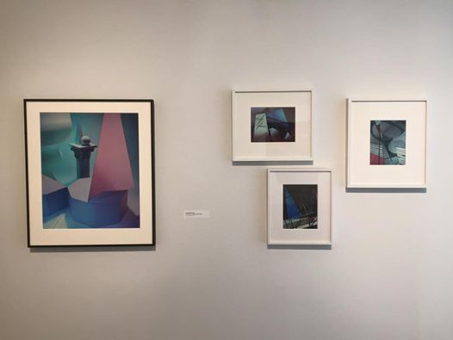

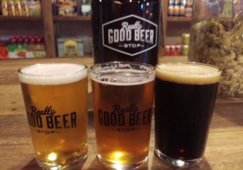
Dataset(Rejected)
Alcohol / Liquor
Paintings

Slide 18




Labeling the Training Dataset
Number of Images after cleaning: 1000+
Labeling of Images for Training:
Classes
Card
Device
Hacker
Money

Slide 19
Train-Validation Split
Images: 1090
80-20% split
Training: 872
Validation: 218
Dataset
1090
Training
872
Validation
218

Slide 20
Architect the Model
Creation of the model
Compile the model
Summary of model
Train the model
Visualize the Model Results
Make predictions

Slide 21
Architect the Model
Sequential
Rescale(1./255, input(img_height,img_width,3))
Conv2D(16, 3, activation='relu')
MaxPooling2D()
Conv2D(32, 3, activation='relu')
MaxPooling2D()
Conv2D(64, 3, activation='relu')
MaxPooling2D()
Conv2D(64, 3, activation='relu')
MaxPooling2D()
Flatten()
Dense(128, activation='relu')
Dense(num_classes)

Slide 22
Results
Epoch | Training Loss | Training Accuracy | Validation Loss | Validation Accuracy
1 | 48.88 | 90.37 | 36.80 | 91.74
6 | 13.26 | 95.76 | 23.31 | 94.95
11 | 7.05 | 97.36 | 29.67 | 96.33
16 | 1.87 | 99.43 | 29.67 | 96.33
21 | 0.82 | 99.77 | 25.12 | 96.79
26 | 0.65 | 99.77 | 24.92 | 96.33
30 | 0.65 | 99.77 | 24.10 | 96.33

Slide 23
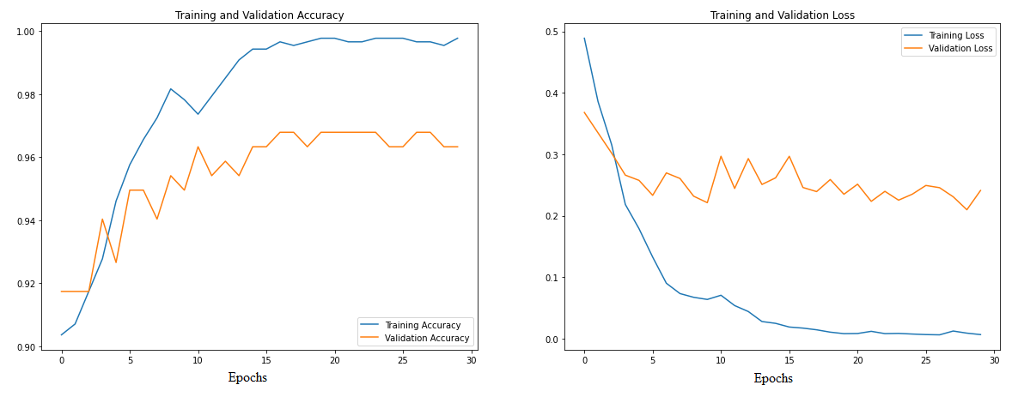
Results
Epochs=30

Slide 24
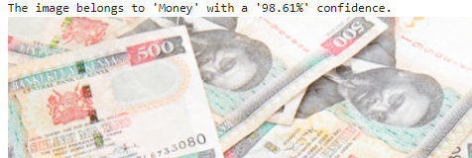
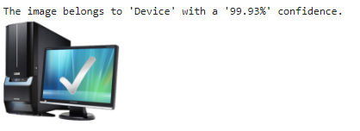
Results

Slide 25
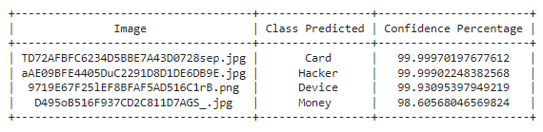
Results

Slide 26
Next Steps
Improvement in Image Recognition part.
Text data analysis of related hidden services.
Presenting both the image and text analysis results for any hidden service so that type of hidden service is identified effectively and correlation can be drawn between image and text data.

Slide 27
Conclusion
The proposed work aims to classify dataset images into classes belonging to categories of contents that existing works do not cover, confirming the correlation between textual and image data by classifying images and analysing respective textual contents.
A model for identification of category of images has been created and used for identifying the category of test images.
A labelled dark web multi-class dataset has been created and will be made publicly available for the academic and research community for future works in this domain.

Slide 28
References
Eduardo Fidalgo, Enrique Alegre, Víctor González-Castro , Laura Fernández-Robles ; “Illegal Activity Categorisation in DarkNet Based on Image Classification Using CREIC Method”; Conference: International Workshop on Soft Computing Models in Industrial and Environmental Applications Computational Intelligence in Security for Information Systems Conference International Conference on European Transnational Education, 2018
Ailanthus; https://blog.torproject.org/nine-questions-about-hidden-services/, 2015
Saiba Nazah, Shamsulhuda, Jemal Abawajy, Mohammad Mehedi Hassan; “Evolution of Dark Web Threat Analysis and Detection: A Systematic Approach”, IEEE Access, 2020
Casey Schmidt; https://www.canto.com/blog/image-tagging/ , 2019
Ryne Knudson; https://brandfolder.com/blog/image-tagging-software , 2021
Bethea Davida; https://towardsdatascience.com/bag-of-visual-words-in-a-nutshell-9ceea97ce0fb , 2018
Eduardo Fidalgo , Enrique Alegre , Víctor González-Castro , Laura Fernández-Robles ; “Classifying suspicious content in tor darknet through Semantic Attention Keypoint Filtering” , Digital Investigation Journal, 2019
Roberto A. Vasco-Carofilis , Eduardo Fidalgo, Francisco Janez-Martino, Pablo Blanco-Medina; “Classifying Suspicious Content in Tor Darknet” , JNIC 2020 Conference.
Vaibhav Pandit, Rishabh Gulati, Chaitanya Singla, Dr. Sandeep Kr Singh; “DeepCap: A Deep Learning Model to Caption Black and White Images”, 10th International Conference on Cloud Computing, Data Science & Engineering (Confluence), 2020
Dr. S. V. Viraktamath, Kshama Tallur, Rohan Bhadavankar, Vidya; “Review on Detection of Fake Currency using Image processing Techniques”, Proceedings of the Fifth International Conference on Intelligent Computing and Control Systems (ICICCS 2021)

Slide 29
References
Risab Biswas, Avirup Basu, Abhishek Nandy, Arkaprova Deb, Kazi Haque, Debashree Chanda; “Drug Discovery and Drug Identification using AI” , Indo – Taiwan 2nd International Conference on Computing, Analytics and Networks (Indo-Taiwan ICAN 2020)
Tufail Sajjad Shah Hashmi, Nazeef Ul Haq, Muhammad Moazam Fraz, Muhammad Shahzad; “Application of Deep Learning for Weapons Detection in Surveillance Videos”, International Conference on Digital Futures and Transformative Technologies, 2021
Susan Jeziorowski; Muhammad Ismail; Ambareen Siraj; “Towards Image-Based Dark Vendor Profiling”, IWSPA ’20, New Orleans, LA, USA, March 18, 2020
Mhd Wesam Al Nabki, Eduardo Fidalgo, Enrique Alegre, and Ivan de Paz; “Classifying Illegal Activities on Tor Network Based on Web Textual Contents”, Proceedings of the 15th Conference of the European Chapter of the Association for Computational Linguistics, 2017
Abhineet Gupta; “The Dark Web as a Phenomenon: A Review and Research Agenda”, The University of Melbourne, 2018
Rubel Biswas, Eduardo Fidalgo, Enrique Alegre; “Recognition of Service Domains on TOR Dark Net using Perceptual Hashing and Image Classification Techniques”, 8th International Conference on Imaging for Crime Detection and Prevention, ICDP-2017, Madrid 13-15 Dec. 2017
Wisam A. Qader, Musa M.Ameen, Bilal I. Ahmed; “An Overview of Bag of Words;Importance, Implementation, Applications, and Challenges”, Fifth International Engineering Conference on Developments in Civil & Computer Engineering Applications 2019
Lingxi Xie, Qi Tian, Meng Wang, and Bo Zhang; “Spatial Pooling of Heterogeneous Features for Image Classification”, IEEE TRANSACTIONS ON IMAGE PROCESSING, VOL. 23, NO. 5, MAY 2014

Slide 30
References
Svetlana Lazebnik, Cordelia Schmid, Jean Ponce. “Semi-local Affine Parts for Object Recognition”. British Machine Vision Conference (BMVC ’04), Kingston, United Kingdom. pp.779–788. ffinria-00548542f, 2010
E. Fidalgo, E. Alegre , V. González-Castro , L. Fernández-Robles; “Compass radius estimation for improved image classification using Edge-SIFT”, Neurocomputing Journal, 2016
Xiangwen Wang, Peng Peng, Chun Wang, Gang Wang; “You Are Your Photographs: Detecting Multiple Identities of Vendors in the Darknet Marketplaces” , ASIACCS’18, Incheon, Republic of Korea, June 4–8, 2018
Joao Marques ; “Tor: Hidden Service Intelligence Extraction”, University of Amsterdam, 2018
Razaque, A.; Valiyev, B.; Alotaibi, B.; Alotaibi, M.; Amanzholova, S.; Alotaibi, A. “Influence of COVID-19 Epidemic on Dark Web Contents”. Electronics 2021, 10, 2744. https://doi.org/10.3390/ electronics10222744 , 2021
Abhishek Gangwar, E. Fidalgo, E. Alegre, V. González –Castro; “Pornography and Child Sexual Abuse Detection in Image and Video: A Comparative Evaluation”, 8th International Conference on Imaging for Crime Detection and Prevention, ICDP-2017, Madrid 13-15 Dec. 2017
Shrey Srivastava , Amit Vishvas Divekar, Chandu Anilkumar, Ishika Naik, Ved Kulkarni and V. Pattabiraman; “Comparative analysis of deep learning image detection algorithms”, Journal of Big Data, 2021
Pankaj Kumar , Sunidhi Ashtekar , Jayakrishna S. S , Bharath K P , Vanathi P. T , Rajesh Kumar M; “Classification of Mango Leaves Infected by Fungal Disease Anthracnose Using Deep Learning”, Proceedings of the Fifth International Conference on Computing Methodologies and Communication (ICCMC 2021)

Slide 31
References
David Mathew Thomas, Sandeep Mathur; “Data Analysis by Web Scraping using Python”, Proceedings of the Third International Conference on Electronics Communication and Aerospace Technology [ICECA 2019]
Arber S. Beshiri , Arsim Susuri; “Dark Web and Its Impact in Online Anonymity and Privacy: A Critical Analysis and Review”, Journal of Computer and Communications, 2019
Shubhdeep Kaur, Sukhchandan Randhawa; “Dark Web: A Web of Crimes”, Springer Science+Business Media, LLC, part of Springer Nature 2020
Albert Weichselbraun; “Inscriptis - A Python-based HTML to text conversion library optimized for knowledge extraction from the Web”, Journal of Open Source Software, 6(66), 3557. https://doi.org/10.21105/joss.03557 , 2021
Oleksandr Matveiev, Anastasiia Zubenko, Dmitry Yevtushenko and Olga Cherednichenko; “Towards Classifying HTML-embedded Product Data Based On Machine Learning Approach”, National Technical University “Kharkiv Polytechnic Institute”, Kirpicheva st. 2, Kharkiv, 61002, Ukraine, 2021
Said A. Salloum, Mostafa Al-Emran, Azza Abdel Monem and Khaled Shaalan; “Using Text Mining Techniques for Extracting Information from Research Articles”, Intelligent Natural Language Processing: Trends and Applications, Studies in Computational Intelligence 740, https://doi.org/10.1007/978-3-319-67056-0_18, 2018
Bassel Alkhatib, Randa S. Basheer; “Mining the Dark Web: A Novel Approach for Placing a Dark Website under Investigation”, I.J. Modern Education and Computer Science, 2019
Akshaya Udgave, Prasanna Kulkarni; “Text Mining and Text Analytics of Research articles”, - Palarch’s Journal Of Archaeology Of Egypt/Egyptology 17(6). ISSN 1567-214x, 2020

Slide 32
References
Zheng Yan, Weiwei Lui, Shiping Wen, Yin Yang; “Multi-Label Image Classification by Feature Attention Network”, IEEE Access, VOLUME 7, 2019
Lingyun Song, Jun Liu, Buyue Qian, Mingxuan Sun, Kuan Yang, Meng Sun, and Samar Abbas; “A Deep Multi-Modal CNN for Multi-Instance Multi-Label Image Classification”, JOURNAL OF IEEE TRANSACTION ON IMAGE PROCESSING 2018
Jubin Dipakkumar Kothari; “A Case Study of Image Classification Based on Deep Learning Using Tensorflow”, International Journal of Innovative Research in Computer and Communication Engineering, Vol. 6, Issue 4, April 2018
Manali Shaha, Meenakshi Pawar; “Transfer learning for image classification”, Proceedings of the 2nd International conference on Electronics, Communication and Aerospace Technology (ICECA 2018) IEEE Conference Record 42487; IEEE Xplore ISBN:978-1-5386-0965-1
Sajja Tulasi Krishna, Hemantha Kumar Kalluri; “Deep Learning and Transfer Learning Approaches for Image Classification”, International Journal of Recent Technology and Engineering (IJRTE) ISSN: 2277-3878, Volume-7, Issue-5S4, February 2019
Mahbub Hussain, Jordan J. Bird, and Diego R. Faria; “A Study on CNN Transfer Learning for Image Classification”, Conference: UKCI 2018: 18th Annual UK Workshop on Computational Intelligence, At: Nottingham, 2018
Shahzad Qaiser, Ramsha Ali; “Text Mining: Use of TF-IDF to Examine the Relevance of Words to Documents”, International Journal of Computer Applications (0975 – 8887) Volume 181 – No.1, July 2018
SAIBA NAZAH 1 , SHAMSUL HUDA 1 , JEMAL H. ABAWAJY 1 , AND MOHAMMAD MEHEDI HASSAN; “An Unsupervised Model for Identifying and Characterizing Dark Web Forums”, Digital Object Identifier 10.1109/ACCESS.2021.3103319, VOLUME 9, IEEE 2021

Slide 33
Thank You

